Slide 1

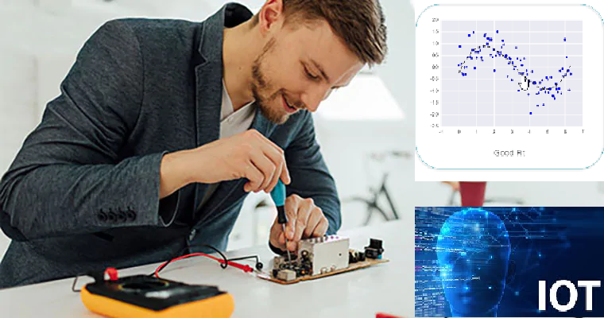



Wearable Devices and Computer Vision
Monday, July 22, 2020
Head Instructor: Jose Luis Ramirez Herran
TA’s: Souleymane Konate and Ricardo Villamil

Slide 2
Summary 1->9
Lecture 1. Students are getting the hardware while we Get started with the Sensor Tile development
Lecture 2. Introduce the basic signal processing concepts
Lecture 3. Introduce image processing – basic image operations
Lecture 4.
Tutorial 1 Troubleshooting
Introduction to Machine Learning and Human Activity Recognition
Numpy, Pandas, Matplotlib and Scikit learn.
Lecture 5. Regression
Lecture 6. Support Vector Machine Classification and PCA
Implementation of SVM in Python
Human Activity Classification Example: Optimizing of the Number and Placements of Wearable IMUs for Automatic Rehabilitation Recording
Lecture 7. Souleymane will us teach about:
Linear Systems in DSP
Impulse Function
Convolution
Low and High Pass Filter
Fourier and FFT
Ricardo is presenting some recent MIT MediaLab’s projects on Wearable Devices
Project Teams and Proposals
Lecture 8. Today’s Class:
SensorTile Tutorial Assignments
Teams and Projects
Lecture 9:
Teams and Projects
Project Report 1 - Presentations
SensorTile Tutorials
Data Collection And Tutorial 9
Today’s Class:
SensorTile Tutorials
Data Collection And Tutorial 8, 9
Teams and Projects
Any Roadblocks?

Slide 3
Today’s Class:
SensorTile Tutorials
Data Collection, Tutorial 8, 9
Teams and Projects
Any Roadblocks?

Slide 4
Questions
How to save the data acquired from the sensortile
Still not clear on how to establish the connection between the sensortile and the python package on the python script
setting up Bluetooth to work, although they did go through it in tutorial 6-8 my laptop had a lot of issues in setup
Observation
Tutorial 9. I have learned that for our project, Tutorial 9 is crucial as it teaches inertial sensing through a demonstration of displacement sensing and introduces the SensorTile Animation system that enables visualization of SensorTile motion sensor data in real-time.
I understan1d we need Tutorial 8 to be able to collect data with Bluetooth. It uses a different firmware and workspace. Data collection will have to wait until we finish up to Tutorial 8?
I only have one sensor-tile, which I need to repeat sit-up multiple times, just collecting different moves on (head) and one more on (arm).
Figure out the best way to collect data
eceive SensorTile acceleration and gyroscope data for control input in Unity
Deciding what type of analysis to do and how best to collect / interprete the data
DELAY IN CHILDREN WITH AUTISM USING MOTION DATA - Literature
Bluetooth
we can imagine that classifying and training data would probably be challenging.
Having trouble with transferring logged data from Putty to Pandas. - Tutorial 9

Slide 5
Linux SBC (single board computers)
RPi
Zero W - you need to know more linux because no HDMI no USB ports,
3 model B + Powered by MicroUSB port, then you need a MicroUSB cable connected to a power source or an adapter
4 - 3 flavors: 1GB, 2GB, 4GB Powered by USB-C ports, then you need a USB-C cable connected to a power source or an adapter
8GB is new, we haven't tested it, it supposed to be better, then you need a USB-C cable connected to a power source or an adapter
Seeedstudio Beaglebone
Beaglebone Green Wireless and Beaglebone Blue (no tested)

Slide 6
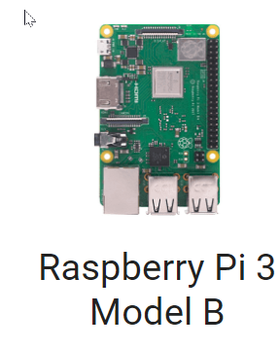
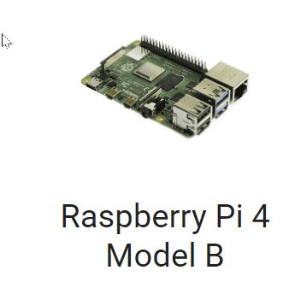
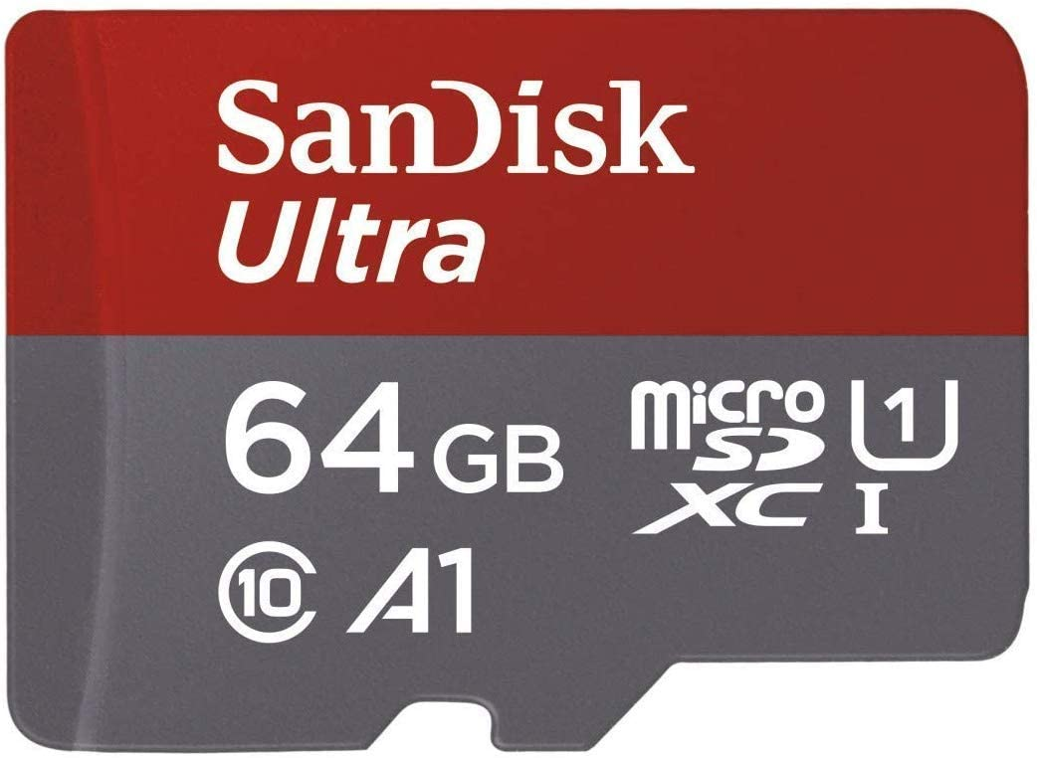
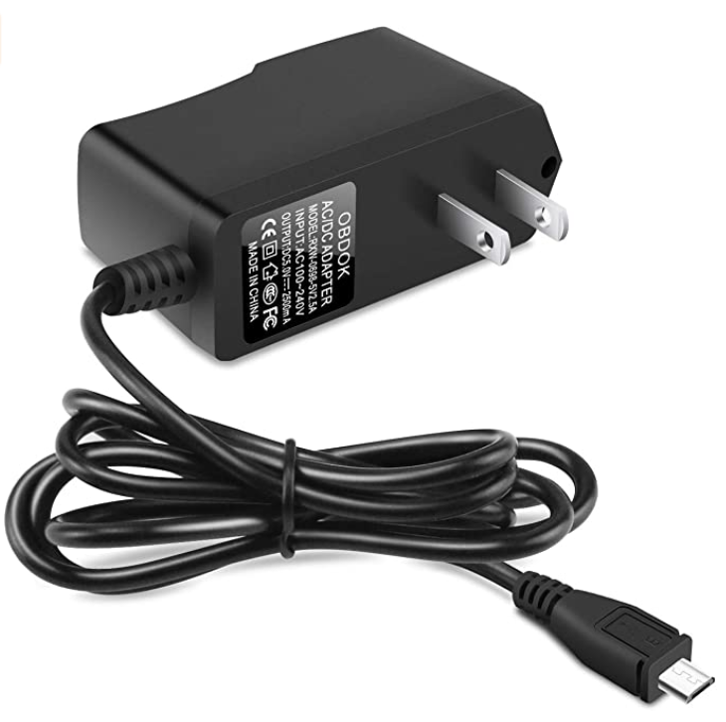
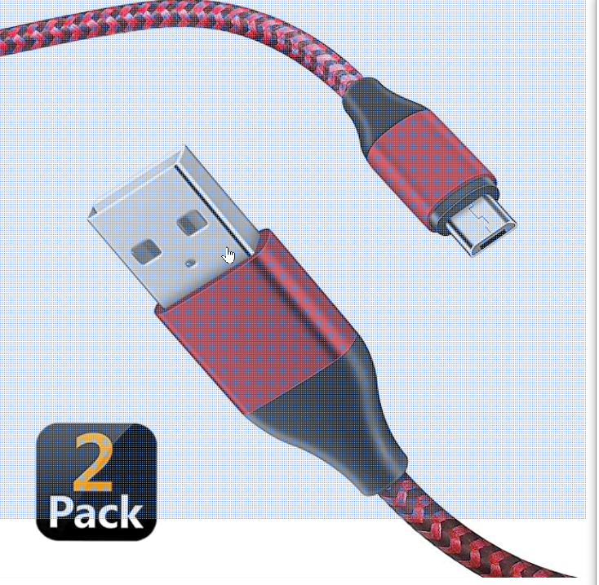
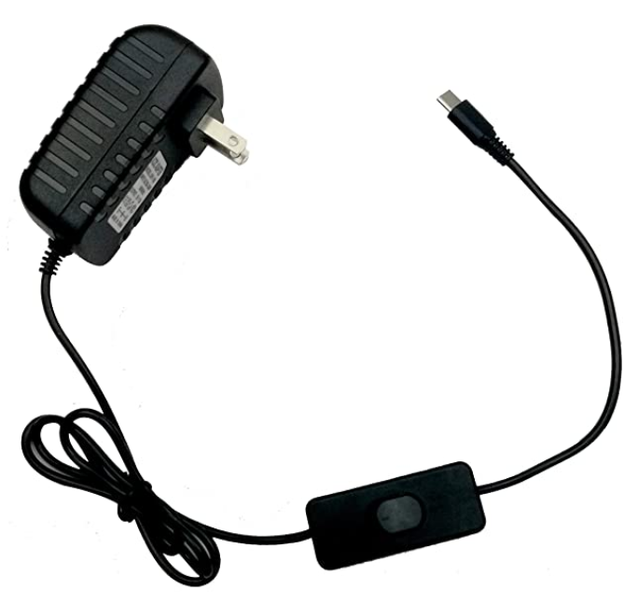
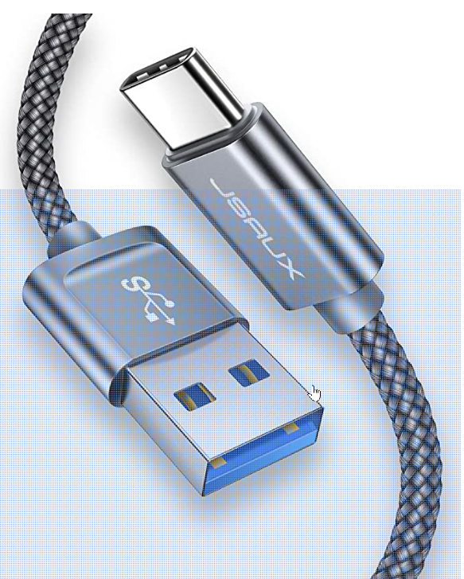
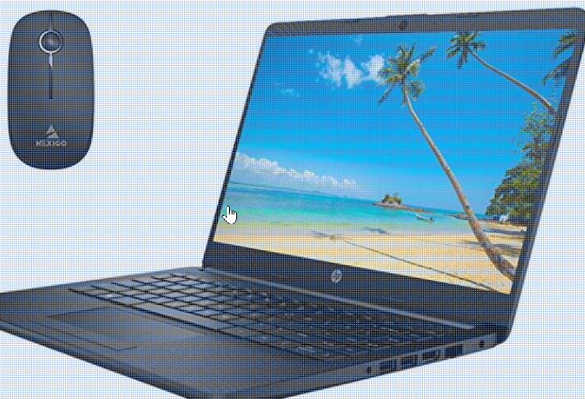
RPi
1GB
1GB,2G,4G,8G
Raspberry Pi 3 Power Supply 5V 2.5A Micro USB AC Adapter Charger US Plug
Raspberry Pi 4 Model B (1GB / 2GB / 4GB) Power Supply Charger AC Adapter 5V 3A PSU Micro USB 3 Feet with Power On/Off Switch
or
or
+
+
OR CanaKit Raspberry Pi 4 4GB Starter Kit - 4GB RAM

Slide 7
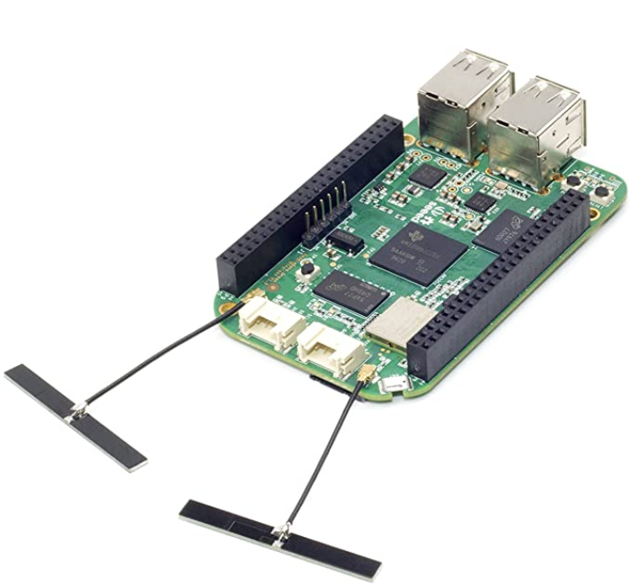
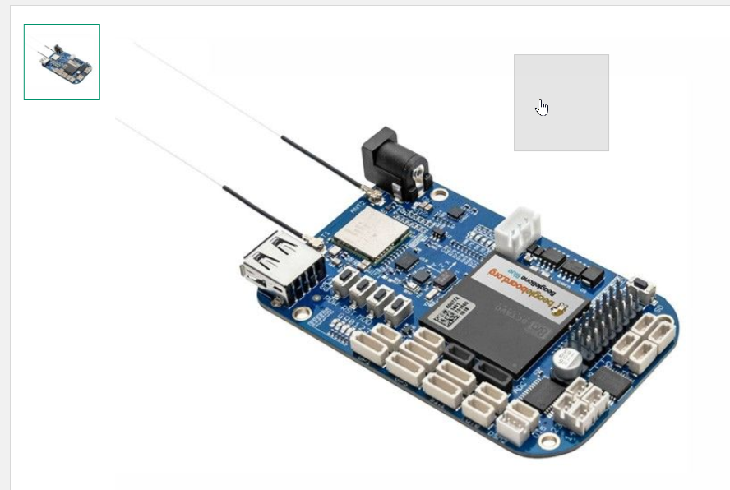
Already tested
or
No tested
seeed studio BeagleBone Green Wireless Development Board（TI AM335x WiFi+BT） with USB Cable
BeagleBone® Blue

Slide 8
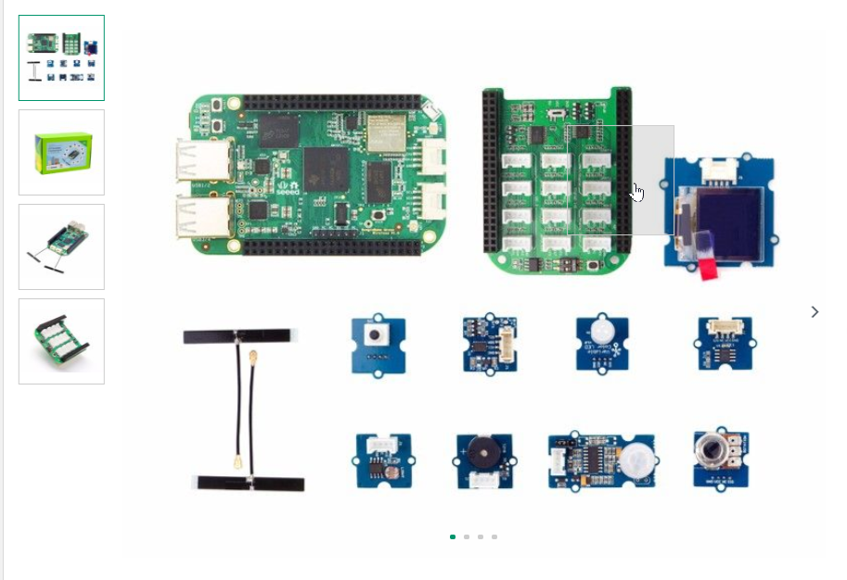
seeed studio BeagleBone Green Wireless Development Board（TI AM335x WiFi+BT） with USB Cable
or
Seeed Studio BeagleBone® Green Wireless IOT Developer Prototyping Kit for Google Cloud Platform

Slide 9
Linux – BLE BlueZ library

Slide 10
Assignments Report1.txt DGMD S-14 (34484) wearable devices
July 22 8:56 pm
Proposal 40/40
Report1 40/40
Quiz1 40/40
Quiz2 40/40
Quiz3 28/40
Tutorial 1 16/40
Tutorial 2and3 11/40
Tutorial 4and5 5/40
Tutorial 6and7 2/40 BLE connection with Linux(optional)
Tutorial 8 (part 1:flashing so you can do BLE(page->10, finish when the sensor is flashed), part2 BLE with Linux (optional) and 9 1/40

Slide 11
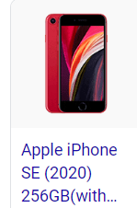
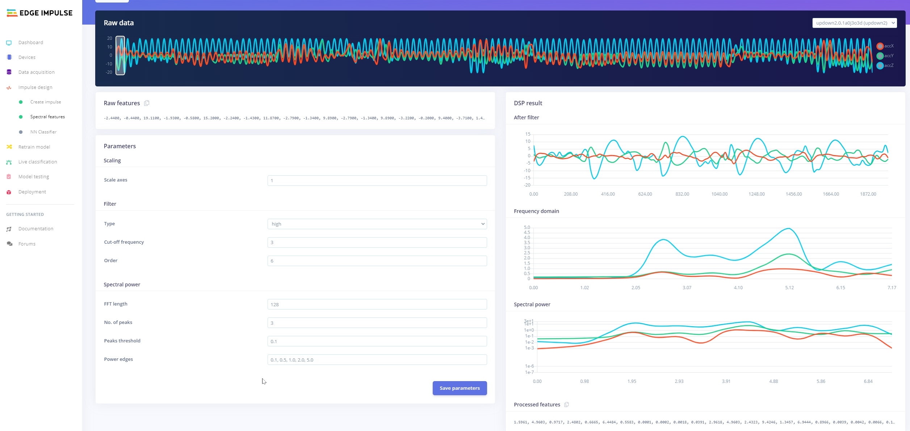
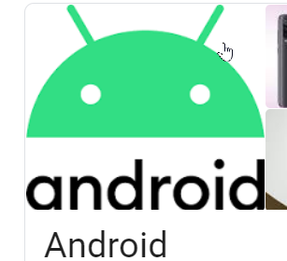
Edge Impulse
Edge Impulse
Only Acceleration and Microphone

Slide 12
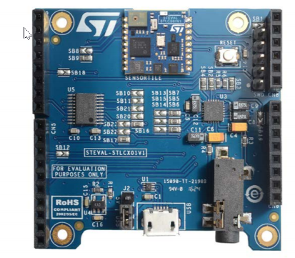

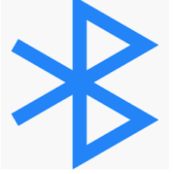
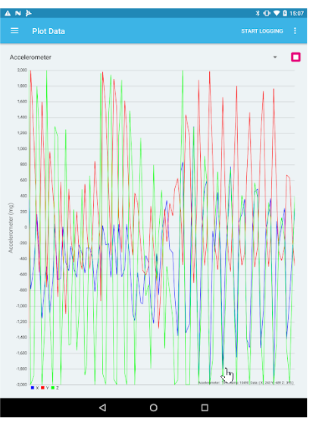
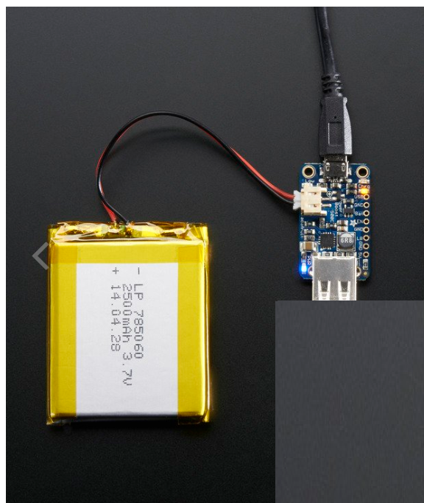
Powering the sensortile with a lipo battery via a power boooster
SensorTile and cradle expansion with sensor
All signals
AWS Cloud
Google Cloud
IBM Watson
Lithium Ion Polymer Battery - 3.7v 2500mAh
BLE Sensor App
PowerBoost 500 Charger - Rechargeable 5V Lipo USB Boost @ 500mA+
Edge Impulse
Only Acceleration and Microphone
Terminal
$ gatttool -b <MAC_ADDRESS_SENSORTILE> -t random --char-write-req --
handle=0x0012 --value=0100 --listen > motion_data.txt,

Slide 13
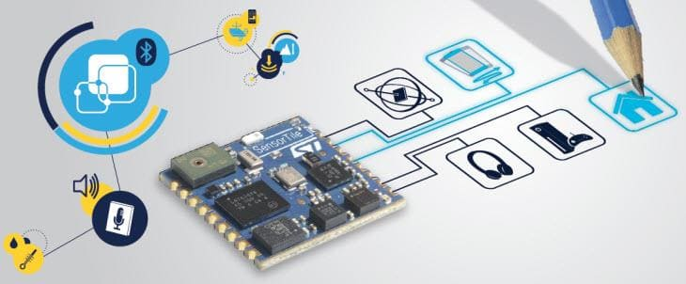
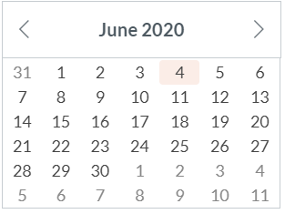
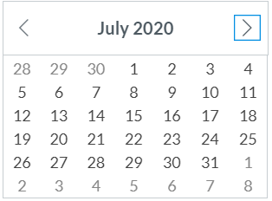
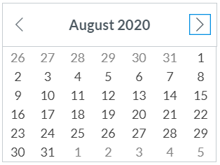
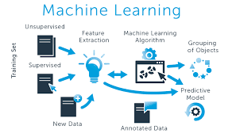
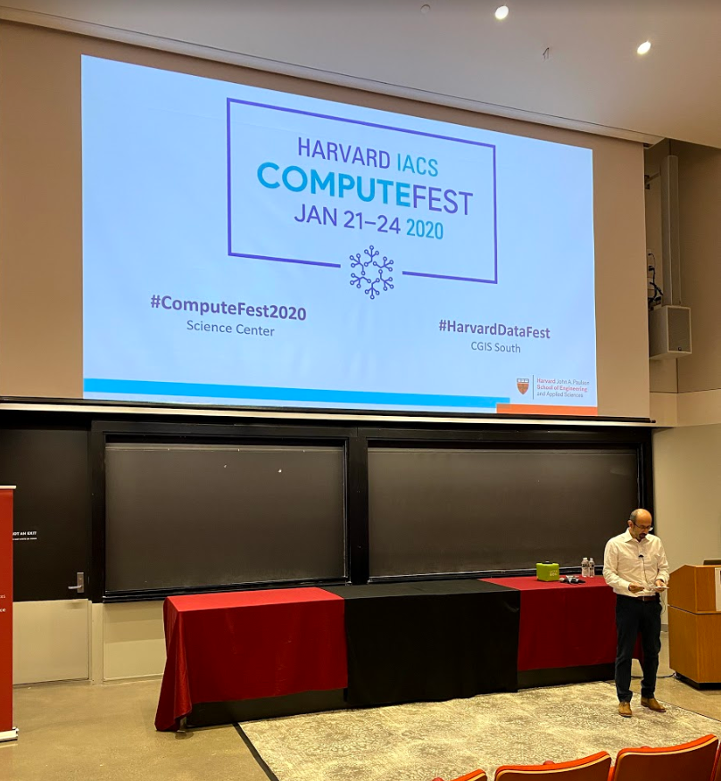
Calendar summer 2020
Mondays and Wednesdays 6:30 pm – 9:30 pm
Wearable Devices and Computer Vision
Lecture 10
Project
presentations
Su M Tu W Th F S
SW+HW Setup.+ Basic Tutorials

Slide 14
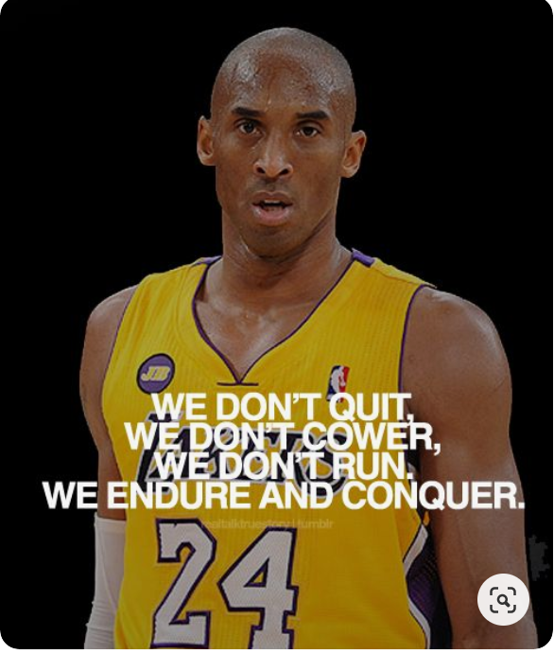
Today’s Lecture
Break
8:00 pm – 8:10 pm
Break
9:00 pm – 9:10 pm
Part 1
Part 2
Data Collection - Projects
Projects and teams - questions
Part 3
Checking in
Questions?
Project Tutorials and Teams
8:10 pm – 9:00 pm
6:30 pm – 8:00 pm
9:10 pm – 9:30 pm

Slide 15
Break
8:10 pm – 8:20 pm
6:30 pm – 8:10 pm
Part 1
Project and Tutorials

Slide 16
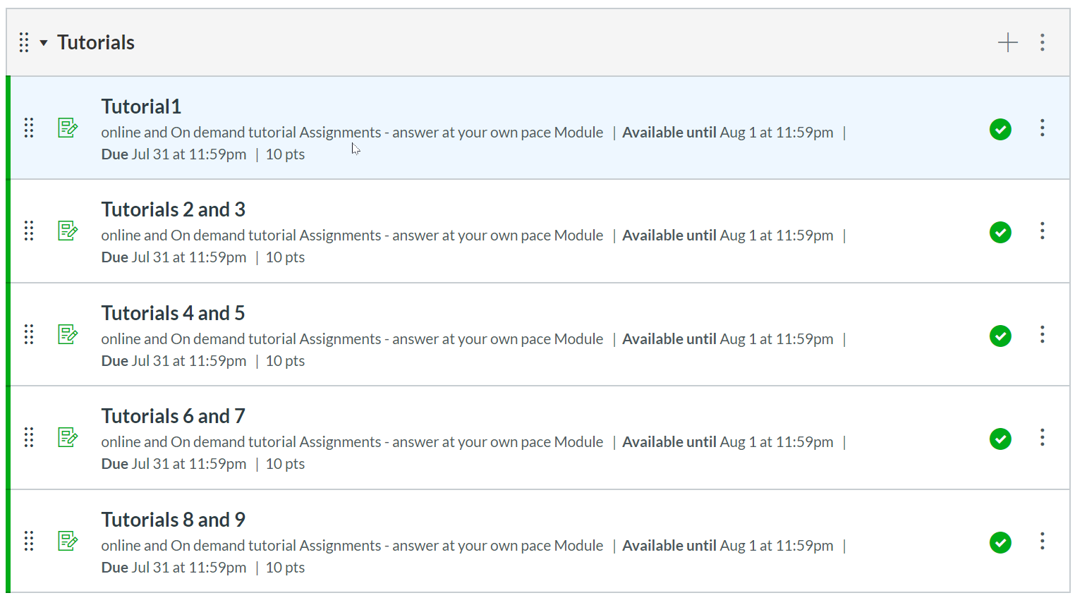
Tutorials

Slide 17
Today’s Lecture
Break
8:00 pm – 8:10 pm
Break
8:40 pm – 8:50 pm
Part 1
Part 2
Data Collection - Projects
Part 3
Questions?
Projects and Teams
Summary
Regression Algorithms by Souleymane Konate
Projects and teams - questions
6:30 pm – 8:00 pm
8:10 pm – 9:00 pm
9:00 pm – 9:30 pm

Slide 18
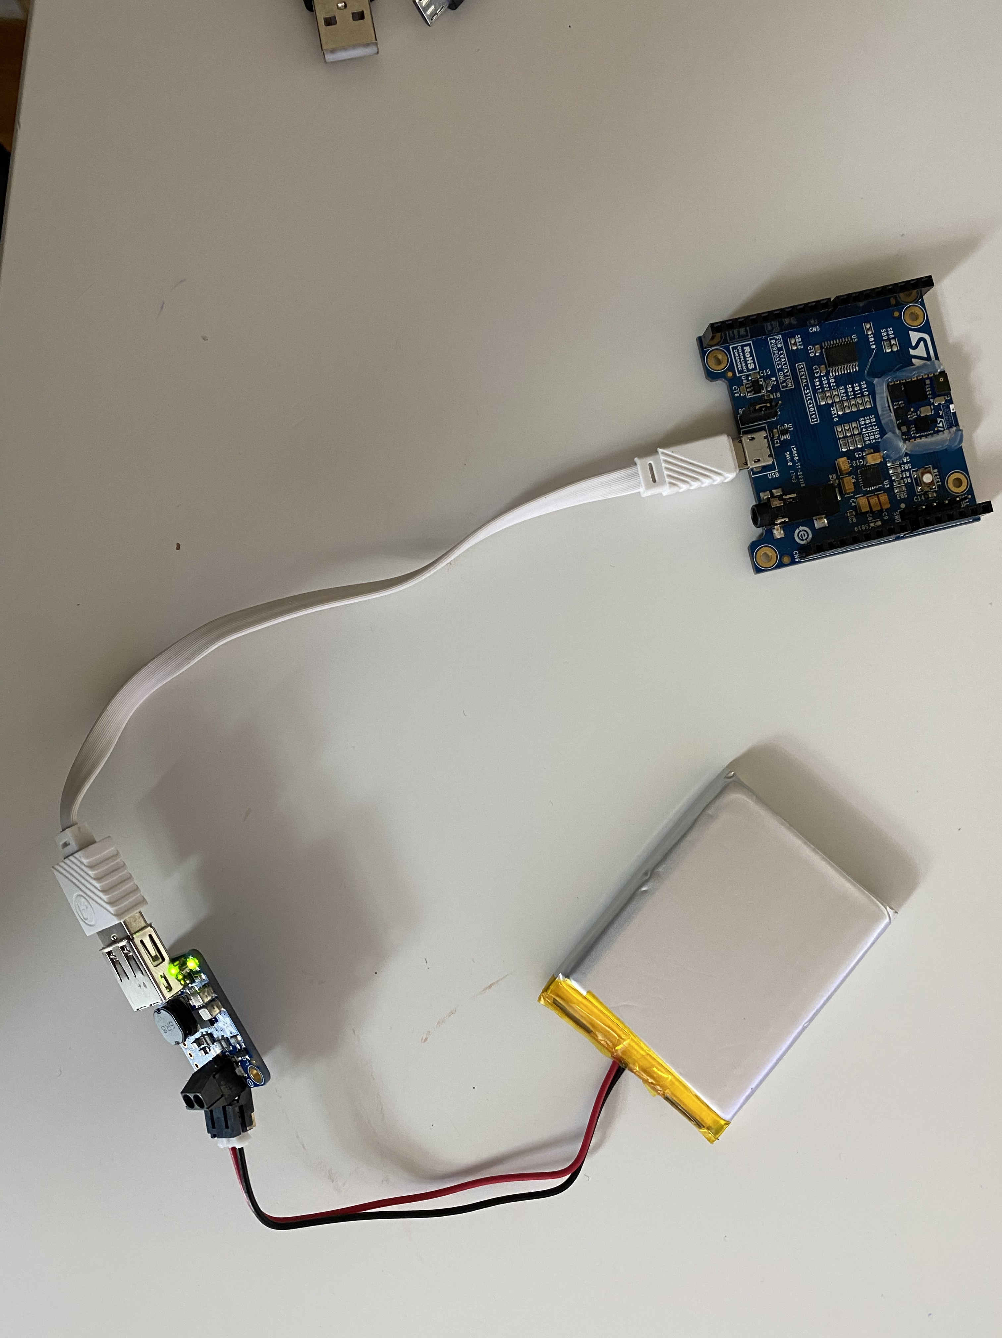
Data collection with the cradle
SensorTile expansion Cradle board equipped with audio DAC, USB port, STM32 Nucleo, Arduino UNO R3 and SWD connector
Tutorial 8 up to page 10.
Config you firmware to send data via BLE (Bluetooth Low Energy)
Compile FP-SNS-ALLMEMS1
Successfully Flash the Sensor with the files above
Disconnect Sensor from any cable
Power the Sensor with a 5V, 1A powers source via microUSB
Connect to the sensor via BLE
Get the data
BinaryFile :
C:\Users\jose\workspace\STM32CubeFunctionPack_ALLMEMS1_V3.1.0\Projects\Multi\Applications\ALLMEMS1\SW4STM32\STM32L476RG-SensorTile\STM32L4xx-SensorTile\Debug\ALLMEMS1_ST.bin
Bootloader:
C:\Users\jose\workspace\STM32CubeFunctionPack_ALLMEMS1_V3.1.0\Utilities\BootLoader\STM32L476RG

Slide 19
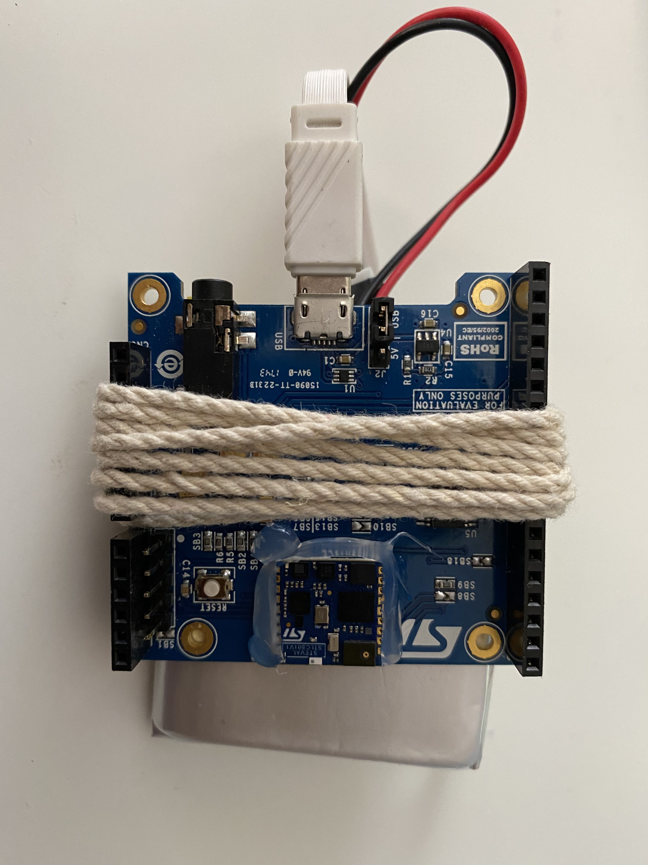
Option 1 using the power boost 3.7 to 5V rechargeable + usb to micro-usb cable

Slide 20
Bill of materials
No. Description url price otherProviders
Item 1 PowerBoost 500 Charger - Rechargeable 5V Lipo USB Boost @ 500mA https://www.adafruit.com/product/1944 $14.95 https://www.digikey.com/product-detail/en/1944/1528-1486-ND/5761270 https://www.amazon.com/dp/B00XW2MEW0?tag=amz-mkt-chr-us-20&ascsubtag=1ba00-01000-org00-win10-other-nomod-us000-pcomp-feature-scomp-wm-5&ref=aa_scomp_sosp1
Options for batteries (vist Adafruit.com):
Lithium Ion Polymer Battery - 3.7v 150mAh
Item 2 Lithium Ion Polymer Battery - 3.7v 2500mAh https://www.adafruit.com/product/328 https://www.digikey.com/products/en?mpart=328&v=1528
https://www.adafruit.com/product/2011
Lithium Ion Polymer Battery Ideal For Feathers - 3.7V 400mAh

Slide 21
Today’s Lecture
Break
7:40 pm – 7:50 pm
Break
8:40 pm – 8:50 pm
Part 1
Part 2
Python for:
Linear and Logistic Regression using Python
Questions
Part 3
Projects and Teams
Questions?
Summary
Regression Algorithms by Souleymane Konate
6:30 pm – 7:50 pm
7:50 pm – 8:40 pm
8:50 pm – 9:30 pm

Slide 22

Teams and projects

Slide 23
Troubleshooting tutorials in canvas
We have very effective office hours so far and we can show some videos were we solved specific problems related with the tutorials. Please take a look in Canvas and we hope this videos help you to get started with the sensorTile curriculum. They will be published into the canvas modules.
Piazza

Slide 24
Office hours
emails TA's:
sok462@g.harvard.edu
ricardo_villamil@fas.harvard.edu
Calendly me:
https://calendly.com/jlr682/wearable-devices-final-project

Slide 25
Questions?

